Slide 1
Cycles, Sinks, and Solutions
A Global Climate Change Unit
Chris Geerer, Alex Gulyas, and Laura Mikesell
Grosse Pointe Public Schools
This unit was created in conjunction with funding and training provided by the National Science Foundation and Michigan Technological University (2014)

Slide 2
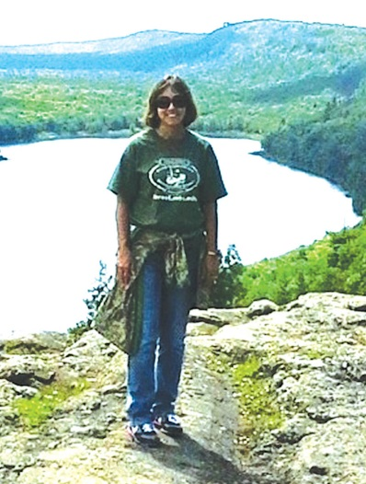
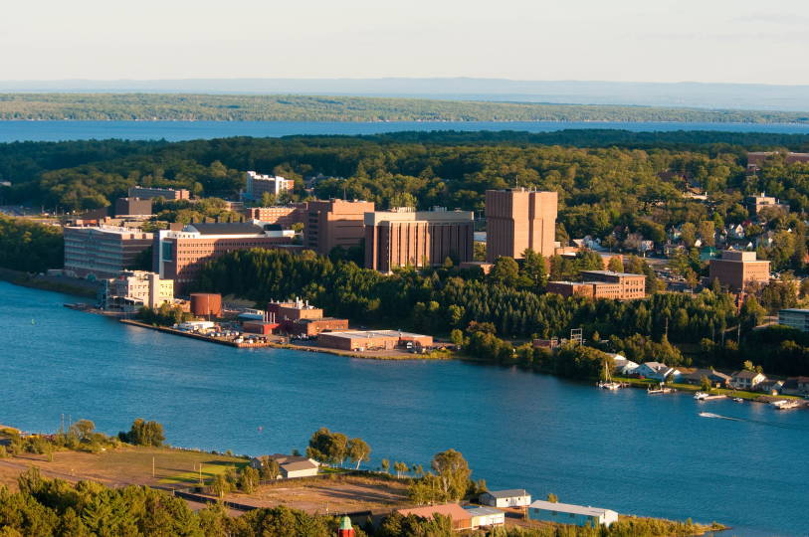
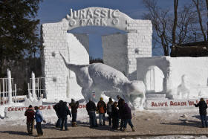
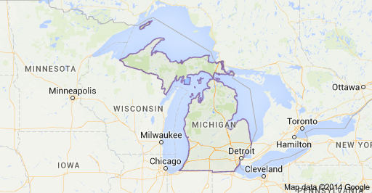
Michigan and Michigan Tech

Slide 3
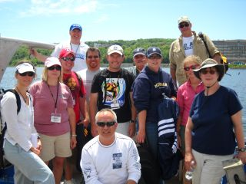
Michigan Tech Teacher Institutes and MiSTAR Project
http://wupcenter.mtu.edu/summer_institutes.html
http://mi-star.mtu.edu/about-mi-star/mi-star-leadership/

Slide 4
NGSS PE for Global Climate Change – Middle School
MS-ESS3-5. Ask questions to clarify evidence of the factors that have caused the rise in global temperatures over the past century. [Clarification Statement: Examples of factors include human activities (such as fossil fuel combustion, cement production, and agricultural activity) and natural processes (such as changes in incoming solar radiation or volcanic activity). Examples of evidence can include tables, graphs, and maps of global and regional temperatures, atmospheric levels of gases such as carbon dioxide and methane, and the rates of human activities. Emphasis is on the major role that human activities play in causing the rise in global temperatures.]

Slide 5
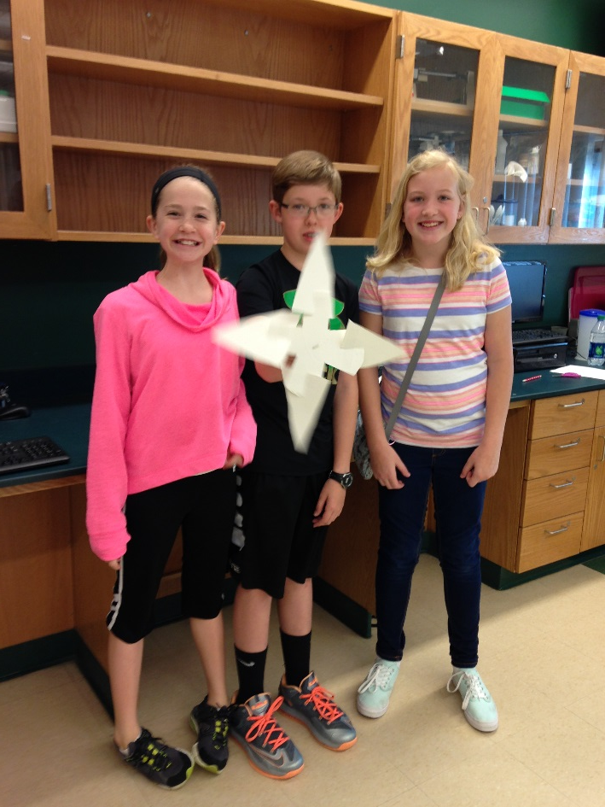
Designing a 5E/NGSX aligned unit:
Engage | Phenomenon: Weird recent local weather/climate event (heat wave, drought, flooding, polar vortex…) Storyline: You are a researcher at a local university writing a grant to study the effects of global climate change on some aspect of the local economy
Explore | Lake Mendota Ice Dates Graphing
Explain | Dancing Molecules Phenomenon: Candle in a jar (NGSX modeling opportunity - may do as part of Carbon Cycle lessons) Carbon Cycle Game and Model (embedded assessment)
Extend | How Much Carbon Is In My Tree? Wind Turbine Engineering (meets Engineering PEs)
Evaluate | Local Research Question project (embedded assessment)

Slide 6
Engage
Begin with a local incident of unusual climate (abnormally hot, cold, rainy/flooding, drought…)
Discuss:
What could cause this?
Is there a pattern?
What testable questions could we generate to research?
What are the attributes of a testable question?
How do we evaluate research sources? (C.A.R.S, CER)
How should we react?
Adapt (farming, tourism)
Change behavior (energy generation)

Slide 7
Practice Evaluating Information
Provide groups of students with different articles about local effects of climate change in your area.
Using C.A.R.S. checklist, have students evaluate reliability of the source.
Using C.E.R., have students evaluate the content of the article.

Slide 8
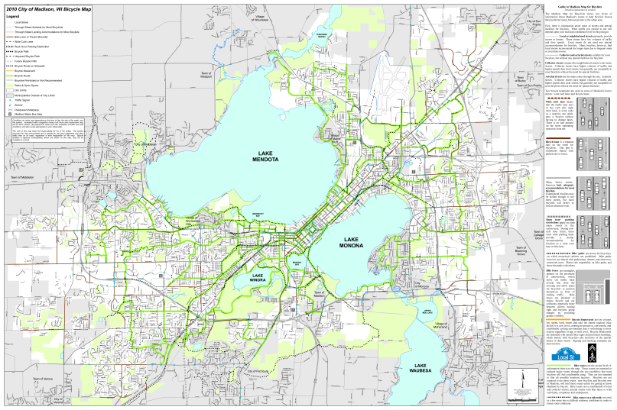
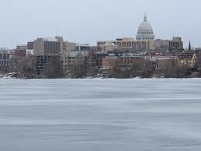
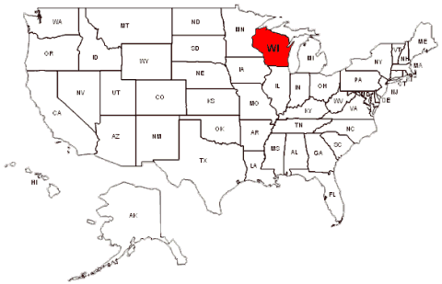
Explore: How do we know the climate is changing? (Argue from Evidence)
One example: Lake Mendota, Madison, WI
Records of ice coverage (in days) from 1855 to present

Slide 9
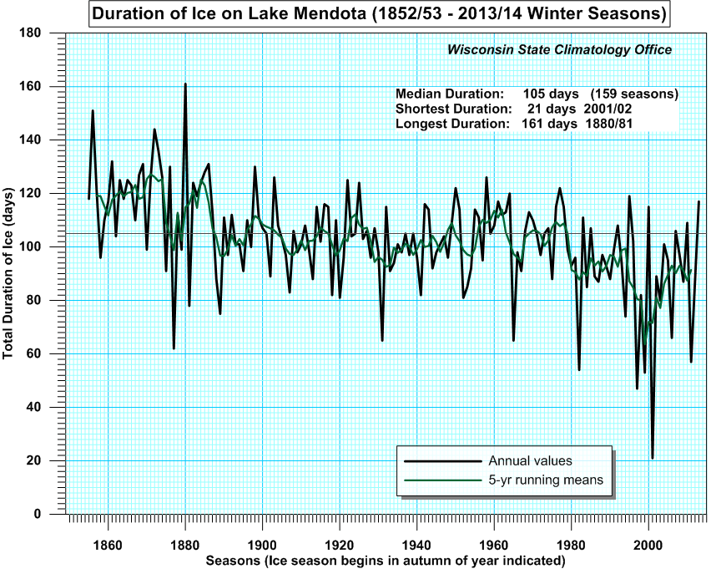

Slide 10
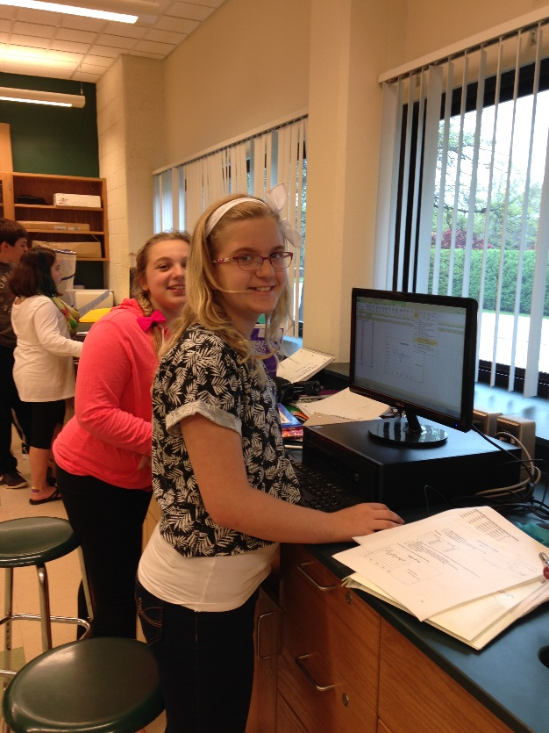
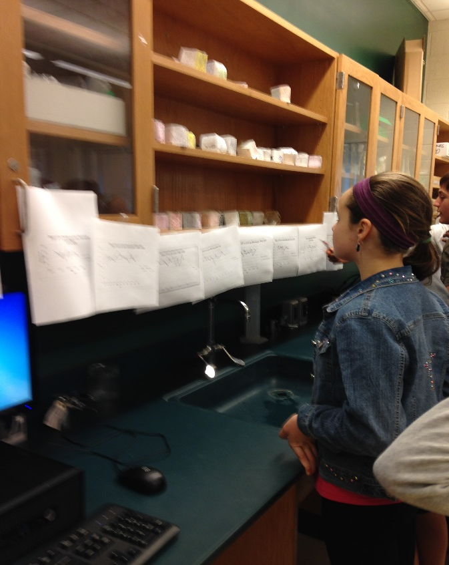
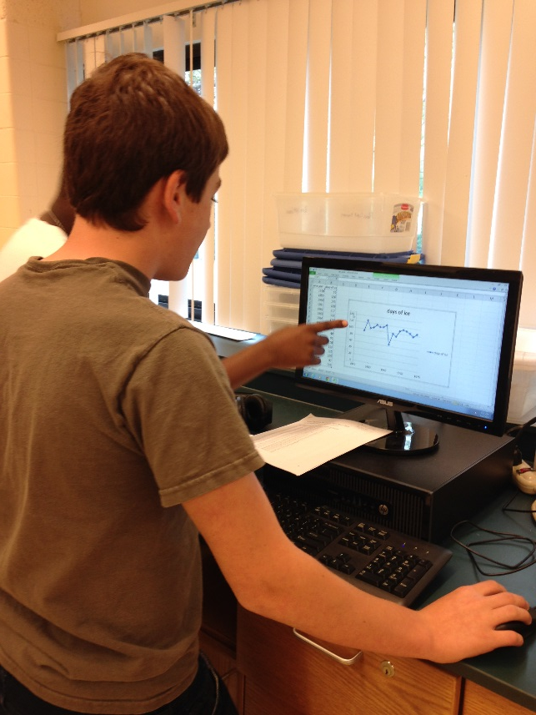
Student Activity: Graph the Ice Duration Data (Math and Technology)
https://www.youtube.com/watch?v=8dPAWJzDIuI Lake Mendota Ice Out video
Lake Mendota data set: https://lter.limnology.wisc.edu/about/lakes/mendota_ice_cover

Slide 11
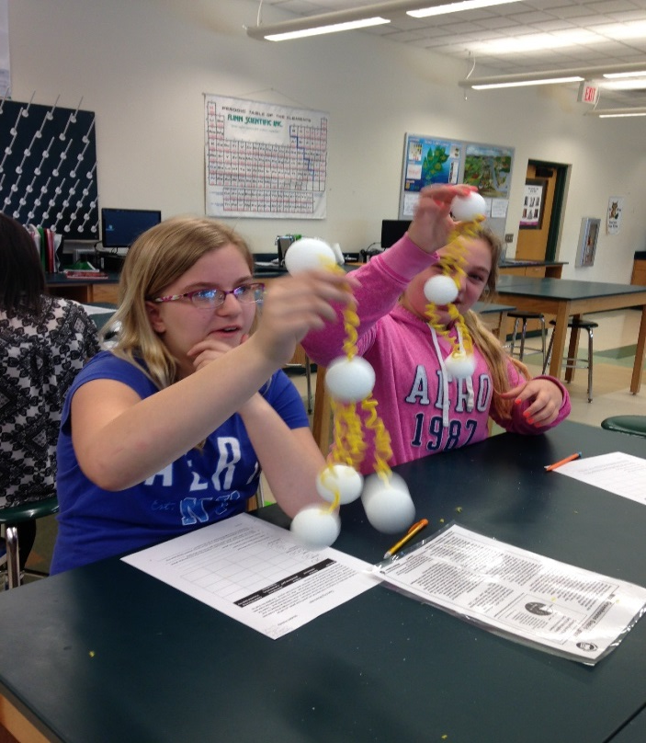
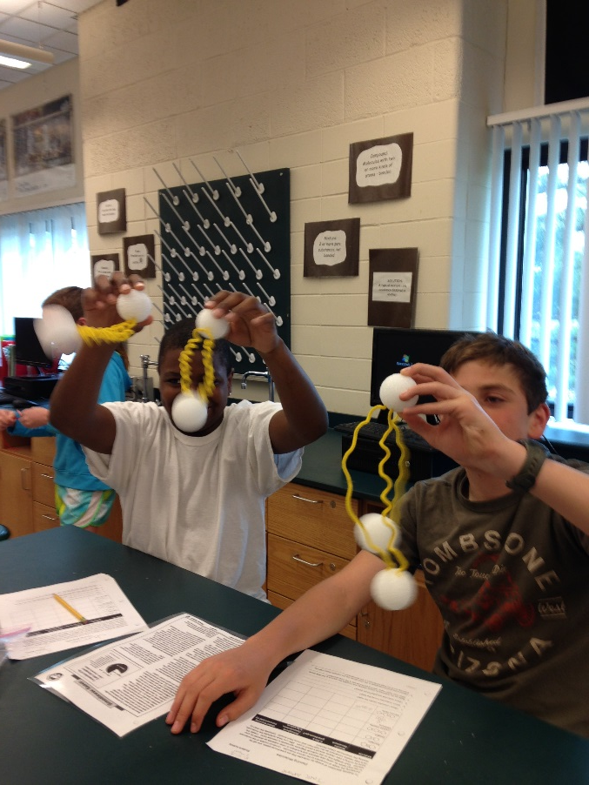
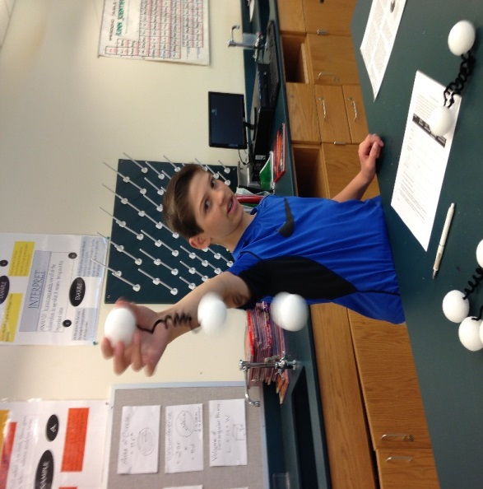
Explain: Greenhouse Effect - Dancing Molecules (Modeling)
https://www.youtube.com/watch?v=AIBk0pGV_BQ
Scott Denning, professor at Colorado State, explains how greenhouse gases dance.
Dancing Molecules student activity (created by Dr. Janet Vail, Grand Valley State University, Michigan)

Slide 12
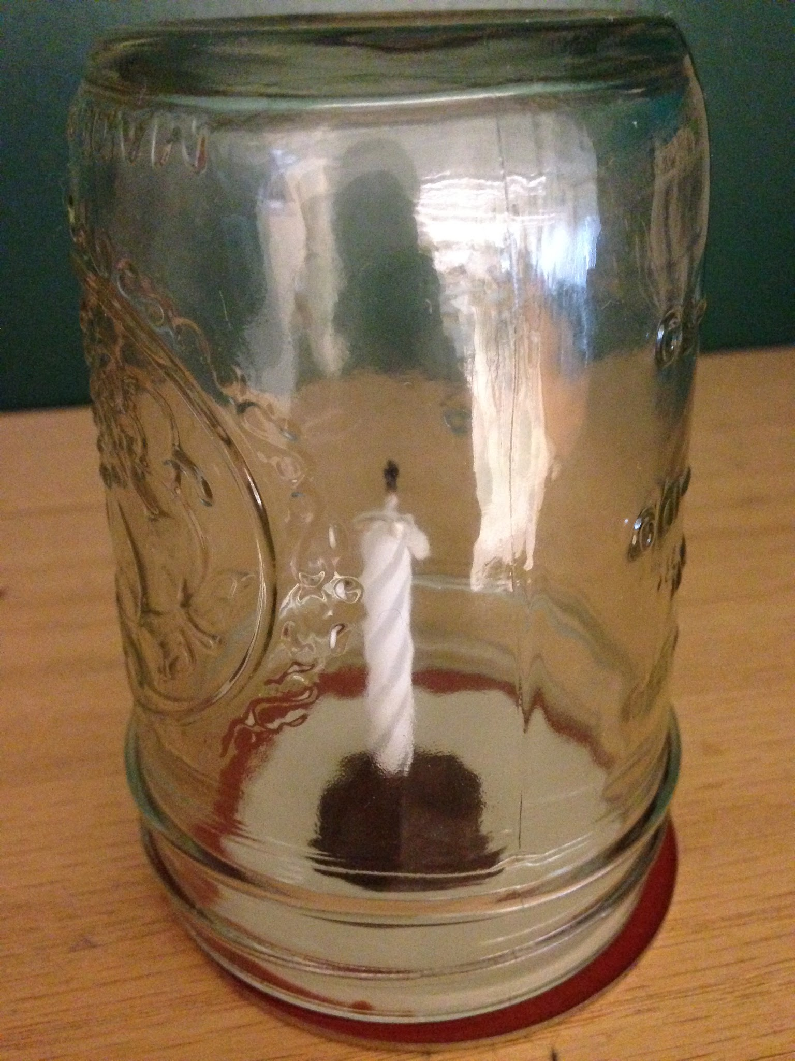
Explain: The Carbon Cycle (Develop Models)
Begin with Candle in a Jar phenomenon
Use NGSX “talk moves” to discuss student-generated models that explain what they’ve observed.
http://learndbir.org/resources/4-Goals_and_Moves-Checklist.pdf

Slide 13
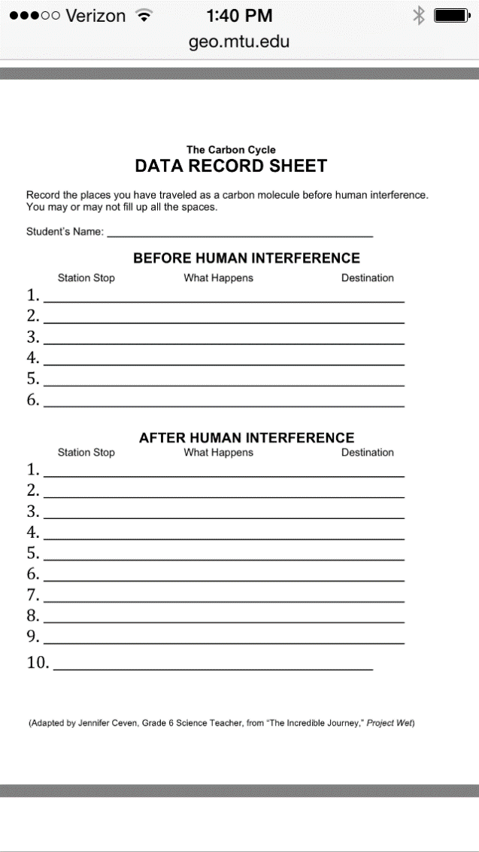
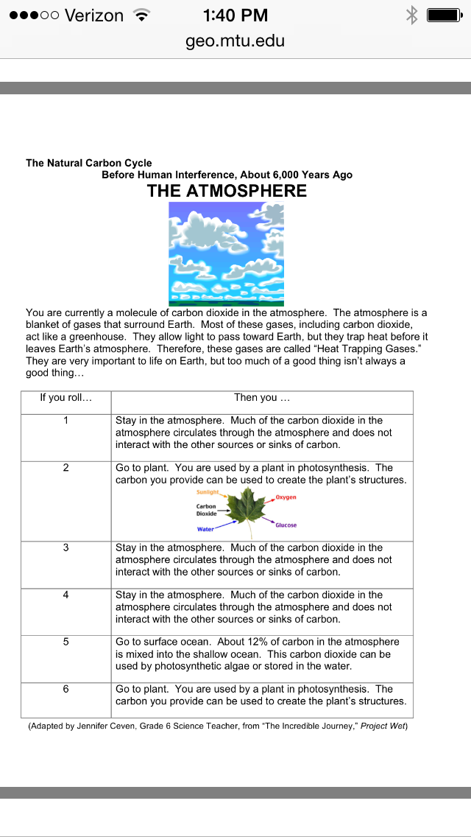
Explain: Carbon Cycle (More Models)
Carbon Cycle Game (adapted from the Incredible Journey, Project Wet, by Jennifer Ceven and further adapted by Michigan Tech MiTEP program teachers) http://www.geo.mtu.edu/~raman/SilverI/MiTEP_ESI-1/Day_7_Core_and_the_subsurface_files/Carbon%20Cycle%20Game_JCevensCredited.pdf

Slide 14
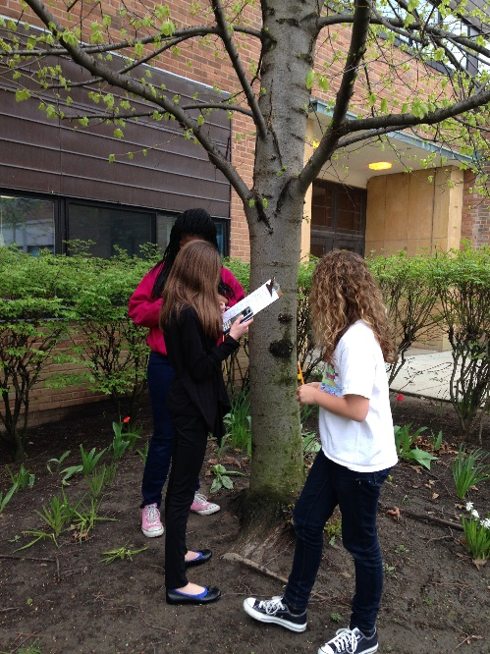
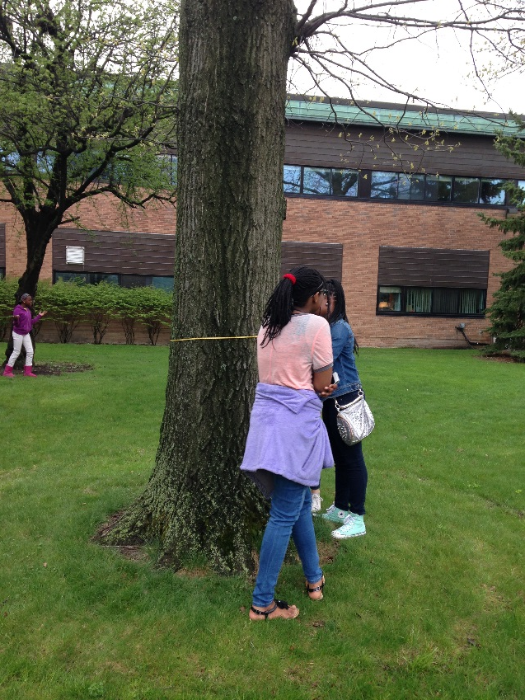
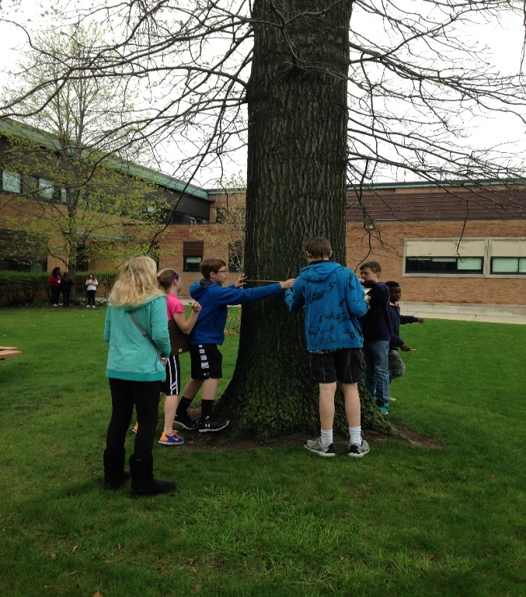
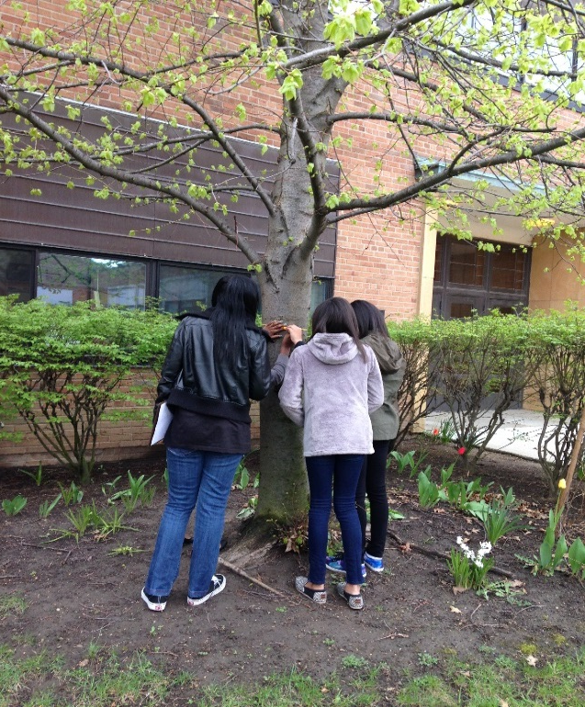
Extend: Trees are Carbon Sinks (Math)
Calculate how much carbon is in a tree…and how many trees you’d need to plant every year just to balance the carbon produced by your family car.
Adapted from Kristen Schmitt, "Carbon Sequestration in Forests." Global Change Teacher Institute. Michigan Technological University, Houghton MI.
This published paper lists carbon content for many other tree species from around the world:
Zianis, Dimitris, and Maurizio Mencuccini. "On Simplifying Allometric Analyses of Forest Biomass." Forest Ecology and Management 187.2-3 (2004): 311-32.

Slide 15
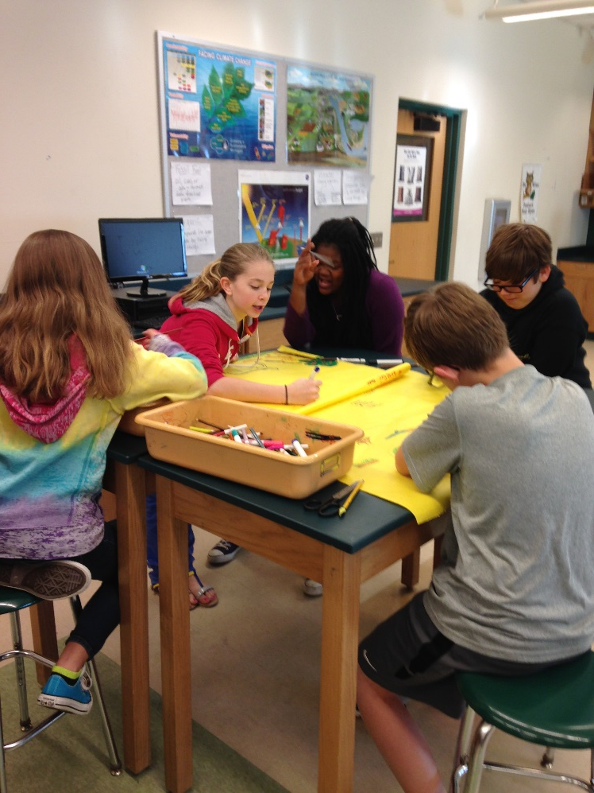
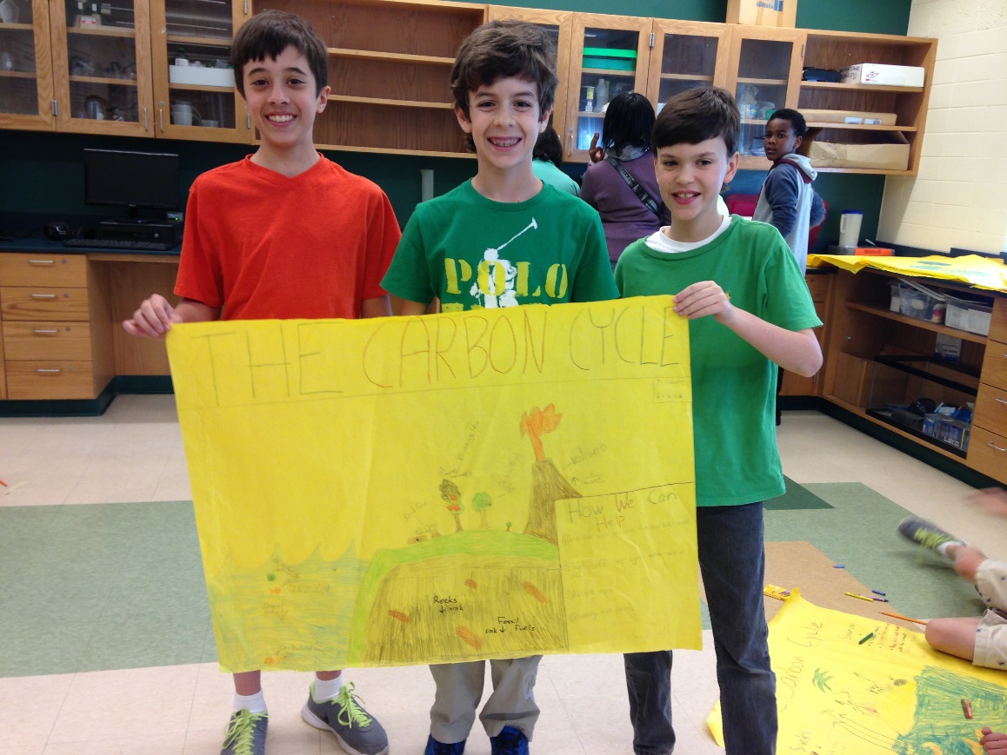
Carbon Cycle Model Embedded Assessment (Modeling, Constructing Explanations)

Slide 16
Evaluate: Getting to the primary SEP (Asking questions to clarify evidence)
Students prepare a research grant proposal on the effects of climate change on a local industry or economy (agriculture, tourism, etc.)
The proposal must include:
A testable question
At least three reliable research sources related to your question.
A logical hypothesis
An argument for the hypothesis using evidence from the three sources.
Skills involve using checklists to evaluate reliability of sources and C. E. R. formats to evaluate article content.

Slide 17
Engineering a Solution
“Scientists dream about doing great things. Engineers do them.”
James A. Michner

Slide 19
Disciplinary Core Ideas

Slide 20
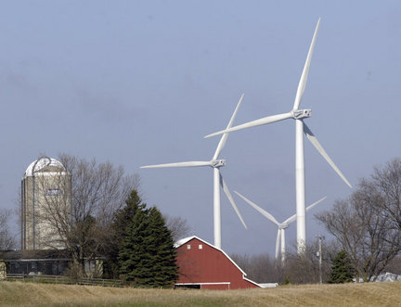
Wind Turbines
https://www.youtube.com/watch?v=sLXZkn2W-lk
https://www.youtube.com/watch?v=8lWTQdHEazg&feature=youtu.be

Slide 21
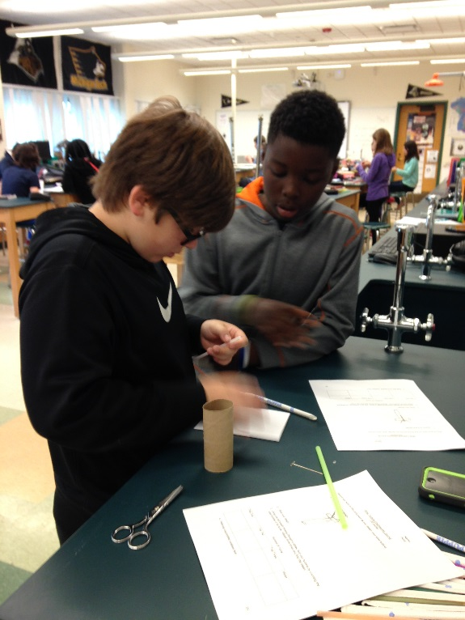
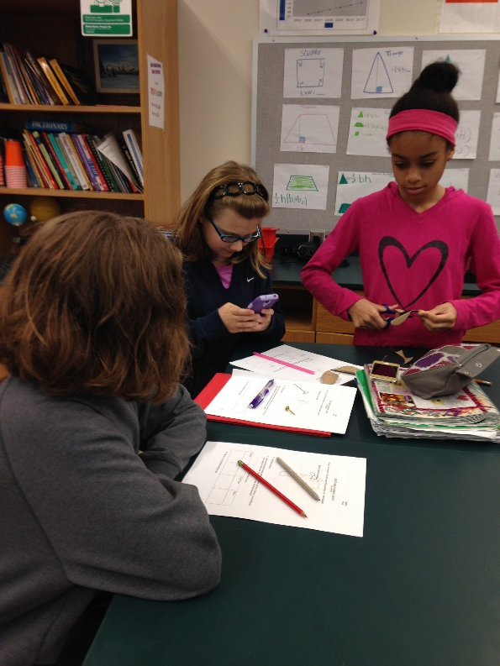
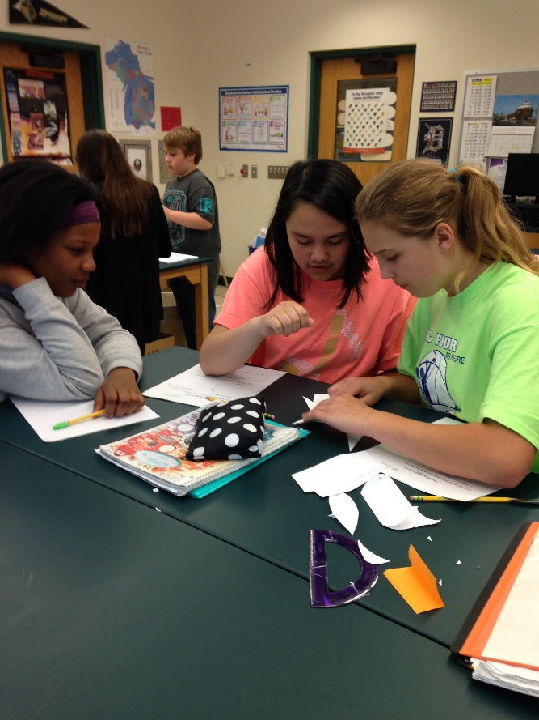
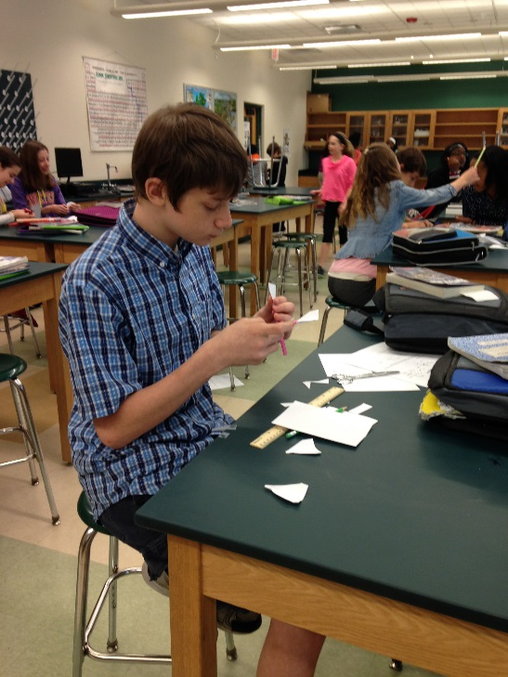
Engineering Challenge
Students build wind turbine models to find the design that rotates longest, using card stock, straws, and pins
Record work in Engineering Journal

Slide 22
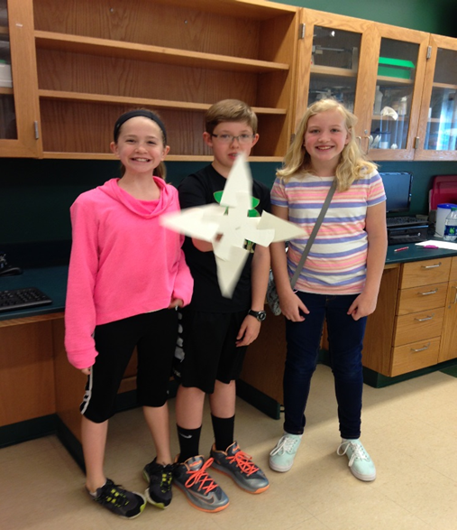
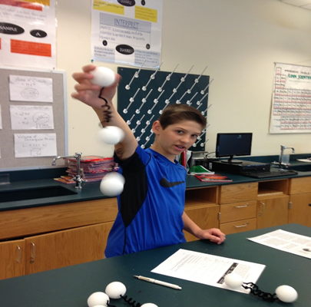
Your turn!
Try out the Dancing Molecules activity
Play the Carbon Cycle game
Design and test a “wind turbine”
This PowerPoint is available on my school website:
http://gpschools.schoolwires.net/Domain/650

